Slide 1
WEB Application Development
Lab work – 2
WEB API .NET Core

Slide 2
What is Web API? API (Application Programing Interface)
API is some kind of interface which has a set of functions that allow programmers to access specific features or data of an application
API can be accessed using HTTP protocol
It is a web development concept and not a technology
can build Web API using different technologies such as Java, .NET etc
ASP.NET Web API supports different formats of response data. Built-in support for JSON, XML, BSON format.

Slide 3
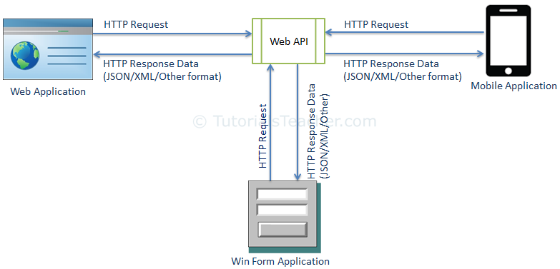

Slide 4
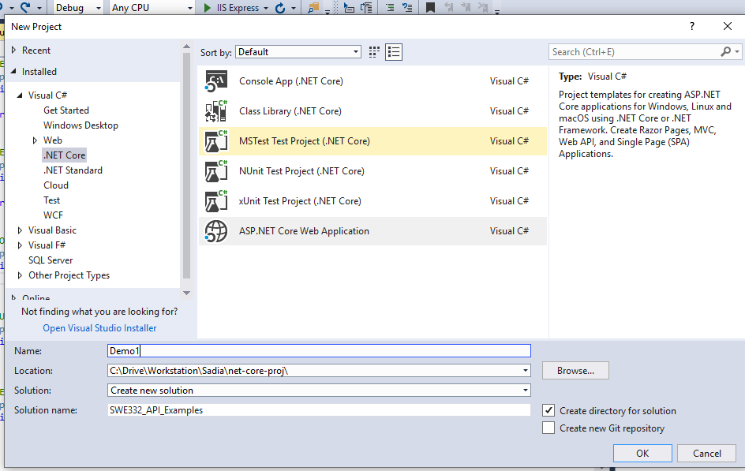

Slide 5
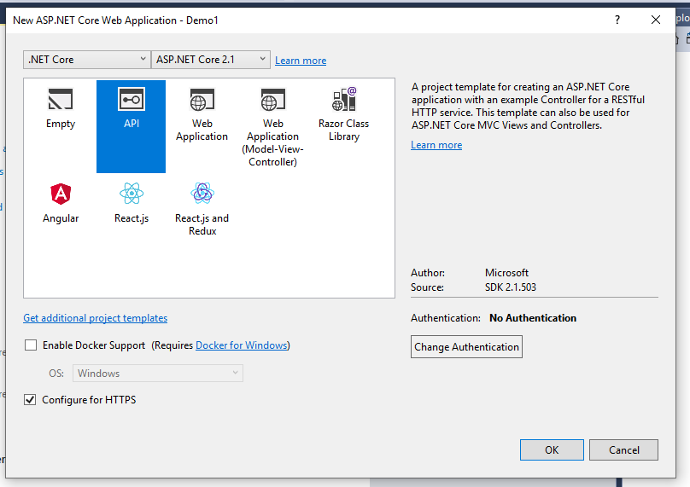

Slide 6
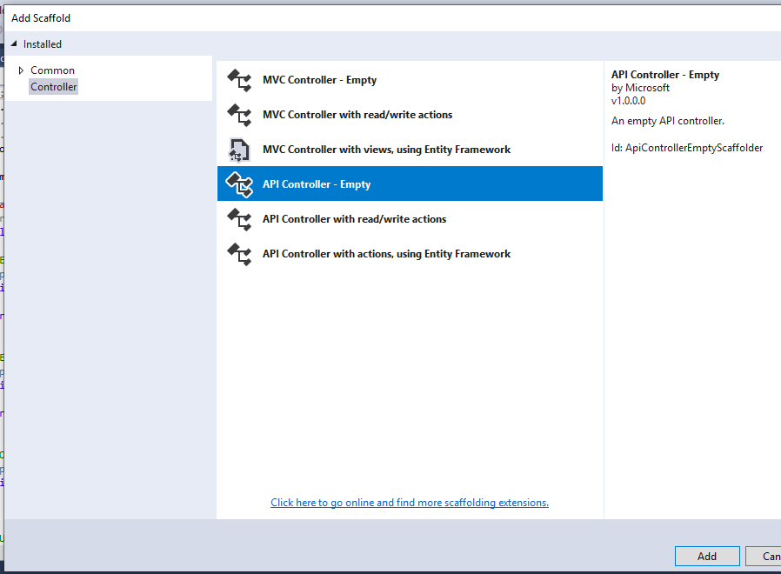

Slide 7
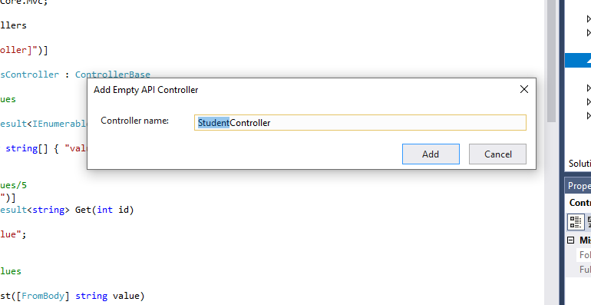

Slide 8
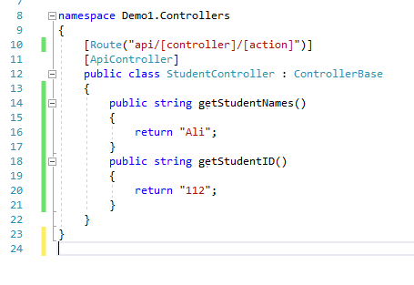
link: https://localhost:44342/api/Employee/getName

Slide 9
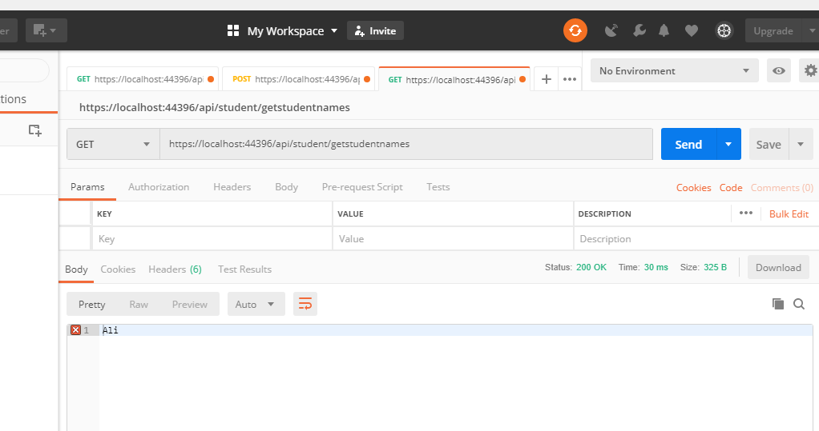

Slide 10
